Slide 1
Anatomy

Slide 2
Objectives to be answered:
What are bones?
What is cartilage?
What are joints?
What are muscles?
What is the skeletal system?

Slide 3
Parts of the musculoskeletal system
Bones and Joints
Muscles
Ligaments
Types and structures

Slide 4
The musculoskeletal system (what is it)?
Muscular + skeletal - Two systems of the body that are closely linked.
Together, your muscles, bones, joints and ligaments are referred to as your musculoskeletal system, and their job is to provide support and movement for your body. This is the body system that provides support, stability, shape and movement to the body.

Slide 5
Key terms
Term
Joint - The point at which two (or more) bones meet
Cartilage - Soft connective tissue found between joints
Ligaments - Connective tissue that attaches bone to bone at a joint
Tendons -Connective tissue that attaches muscle to bone
Voluntary muscle - Muscle that can be consciously controlled
Involuntary muscle - Muscle that is controlled by the autonomic nervous system (not consciously controlled)
Striated muscle - Muscle tissue that has a striped appearance due to its fiber composition

Slide 6
How the musculoskeletal system works
Without your musculoskeletal system, you couldn’t pick up your pencil, sit at your desk, or walk to the lunchroom.
Getting your body to move the way you want it to requires joints, bones, and muscles. Imagine yourself trying to play kickball with a leg that was like a rope.
If you didn’t have bones, your arm would be as floppy as a rope! If you didn’t have joints, you wouldn’t be able to bend your leg to kick a ball.

Slide 7
The Skeletal and Muscle Systems
Together, all the muscles and bones in the body form the skeletal and muscular systems.

Slide 8
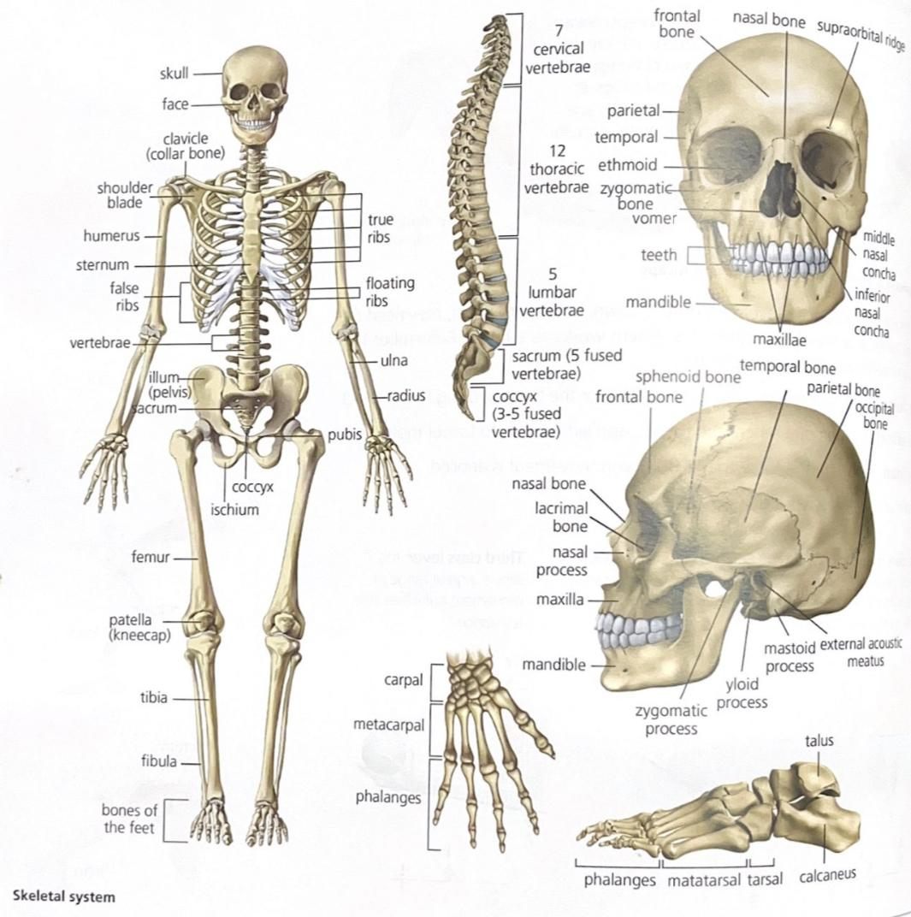
THE SKELETAL SYSTEM
The skeletal system is formed with 206 bones in total. These are grouped into the head, spine, rib cage, and appendicular skeleton.

Slide 9
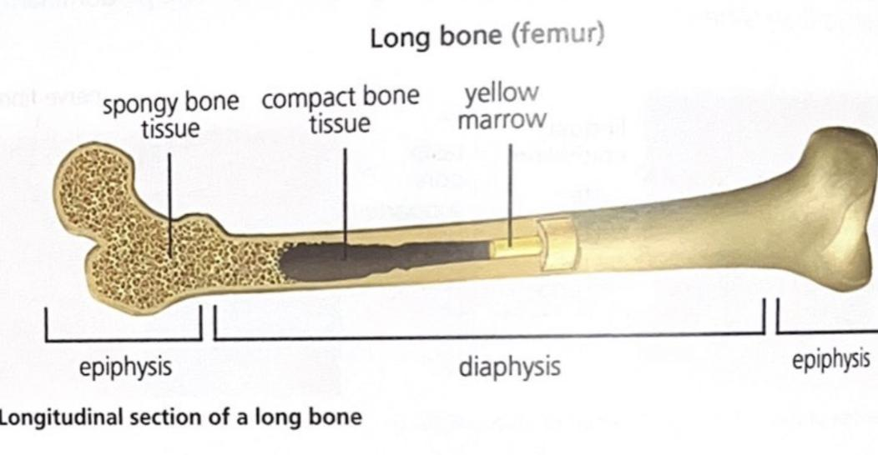
Bones
Bones contain calcium salts that makes them hard and tough. In addition to the inorganic components, they have cells that allow bones to grow and fuse after they break.
They are formed of bone tissue, which can be of two types; spongy bone that presents cavities and compact bone that has no internal spaces.

Slide 10
Bones - JOINTS
Bones join together forming joints that can be of three types: fixed, mobile and semi-mobile joints.
Fixed: these stop the movement of bones. The joints of the cranium bones are an example. The bones of the cranium in newborns are not completely fused. This characteristic allows the head of the fetus to adapt to the shape of the birth canal during birth, preventing damage to the brain. The presence of flexible fibrous tissue called fontanelles facilitates this. During the first 18 months of life, the fontanelles close and the bones of the cranium fuse.
Mobile: these allow bones to move. They contain a lubricating liquid, synovial fluid, which stops the bones from grinding against each other. Ligaments form the actual joint connections. Examples of mobile joints are the elbow, shoulder and knee.
Semi-mobile: these only allow limited movement of the bones. Vertebrae are an example of this type of bone.
Notes:
Ask them what they think examples are for the harder class

Slide 11
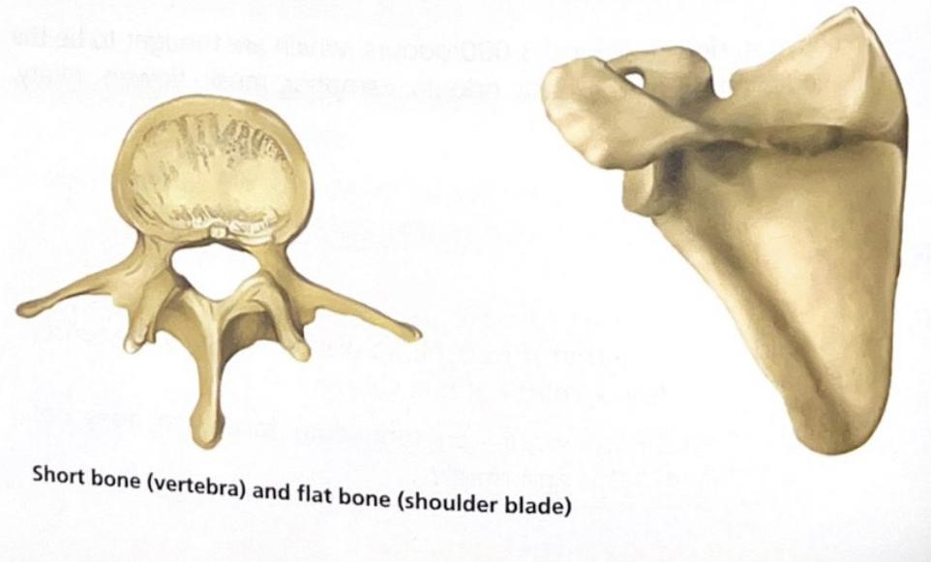
Bones
According to their shape, bones can be long, short or flat:
Long bones: these are long and contain spongy bone tissue at either end (epiphysis), as well as compact bone (diaphysis), They support and move the body. The bones found in our limbs are examples of this particular tope of bone.
Short bones: these are rounded and mostly made up of spongy bone tissue (inside), with a thin outer layer of compact bone tissue. The vertebrae and the wrist bones are examples of short bones.
Flat bones: these are plate-shaped. They are formed by an inner layer of bone tissue surrounded by two layers of compact bone tissue. The function of this bone type is protective. Examples include the skull bone and shoulder blade.

Slide 12
Bones - CARTILAGES
The skeleton also has cartilage, a structure which isn't as hard as bone because it doesn't contain calcium salts. Cartilage is located in the ears, the front part of the nose and in between the vertebrae (it also forms the skeleton of embryos).

Slide 13
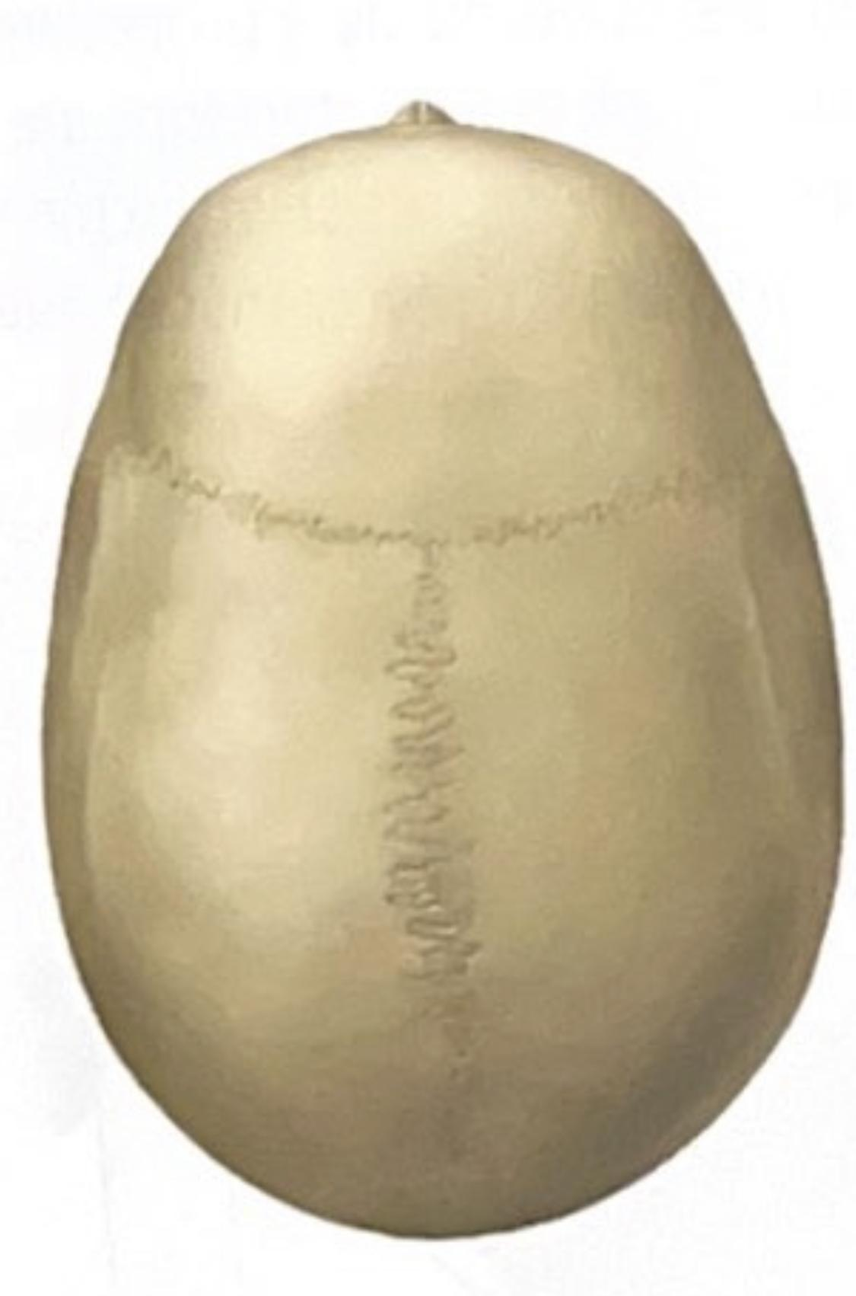
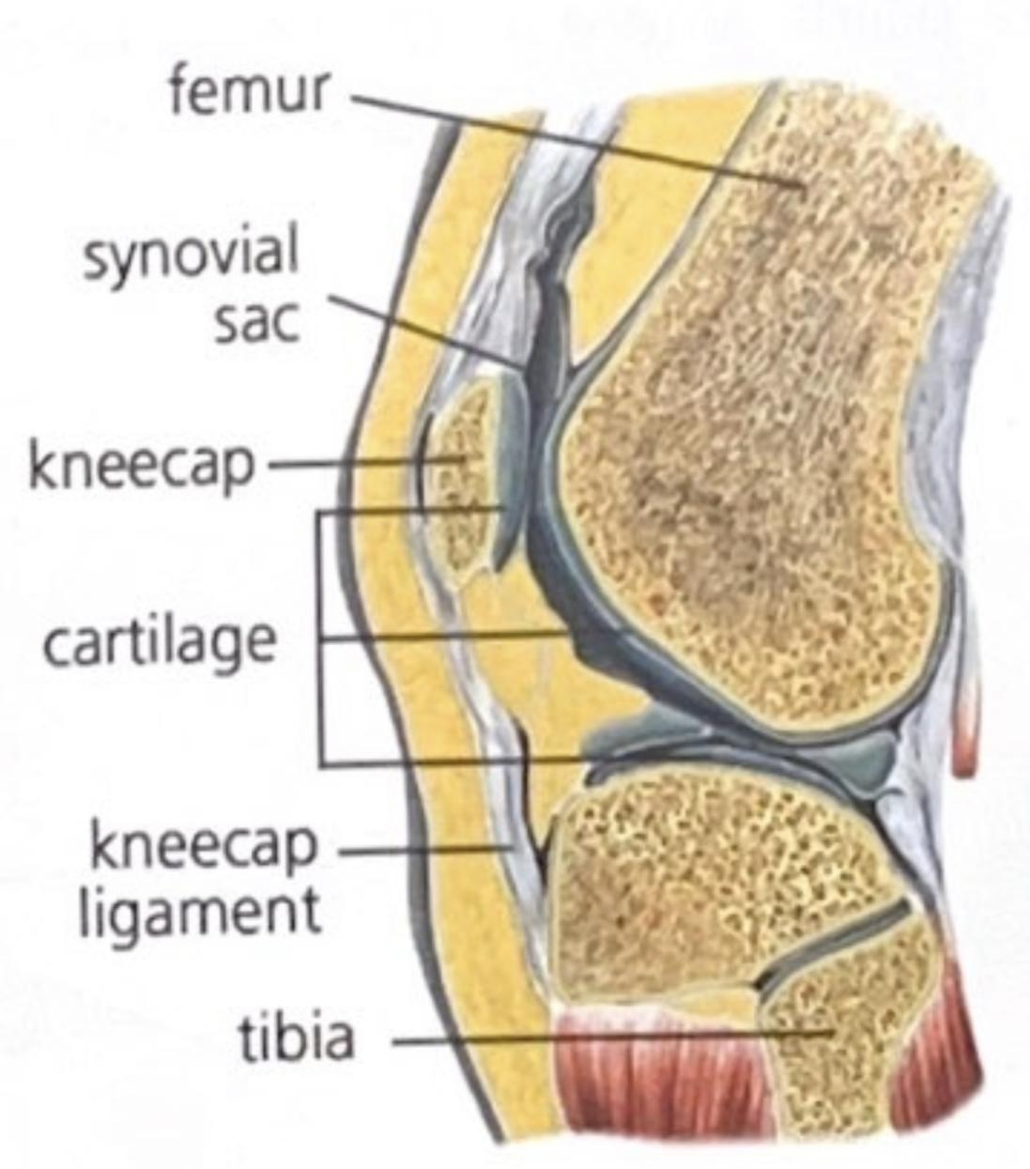
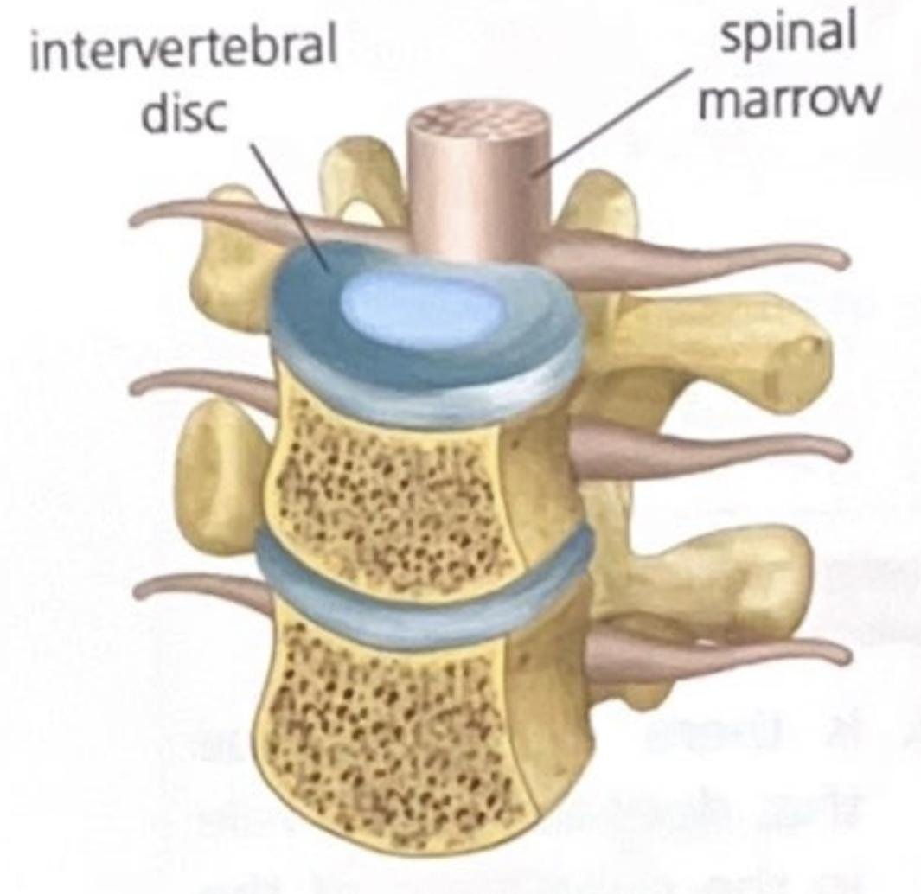
Bones - JOINTS
The functions of bones are as follows:
They anchor the muscles and are passive organs of the locomotor system.
They support the body.
They protect delicate organs (brain, spinal cord...).
They are a calcium reserve for the body.
In the interior of the bones (red marrow), blood cells are created.
Notes:
Ask them what they think examples are for the harder class

Slide 14
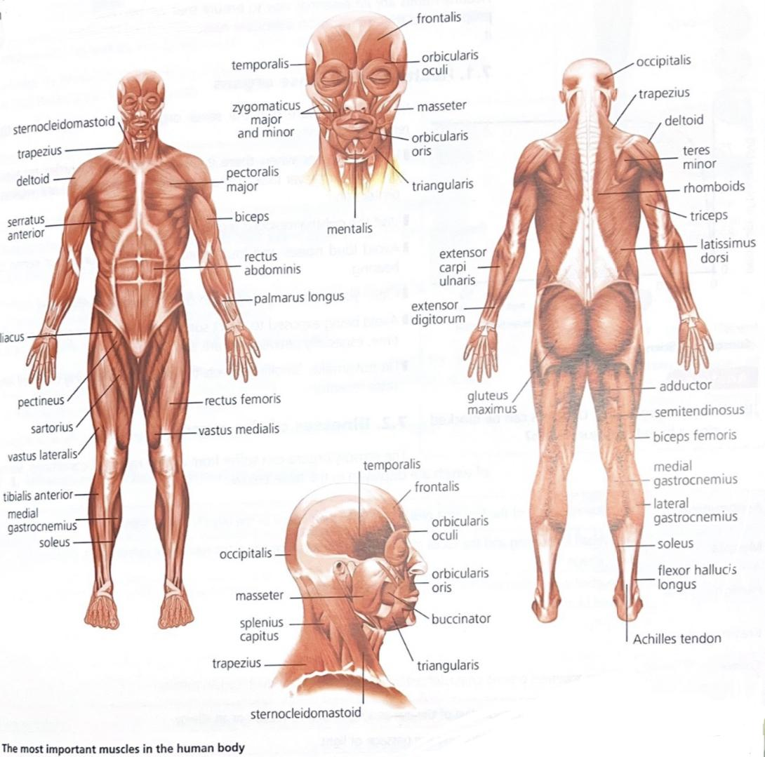
THE MUSCLE SYSTEM
The muscular system is formed of all the striated muscles in the body, of which there are almost 500 in total.

Slide 15
Muscles
Muscles are in charge of maintaining the posture of the body and performing movements (the movement of bones as well as internal organs).
They work using a lever connected with the bones, to which they are joined by tendons.

Slide 16
Muscles - TYPES OF MUSCLES
According to the cells that form them, there are two main groups of muscles.
striated muscle fibre: these muscles join with bones and are responsible for the movements of the bones. They contract voluntarily, they are fast and persistent. Large cells that have several nuclei form them.
smooth muscle fibre: these are part of the internal organs. Their contraction is involuntary; it is slow and long lasting.

Slide 17
Muscles - TYPES OF MUSCLES
According to their shape, they can be long, flat or circular:
Long or fusiform: these normally play a role in the movement of the body. The biceps and triceps are fusiform muscles.
Flat: these generally cover and protect organs. The chest and abdominal muscles are examples of this particular type.
Circular or sphincters: these close or open a cavity or duct. Some of them are found in the eyes and lips.

Slide 18
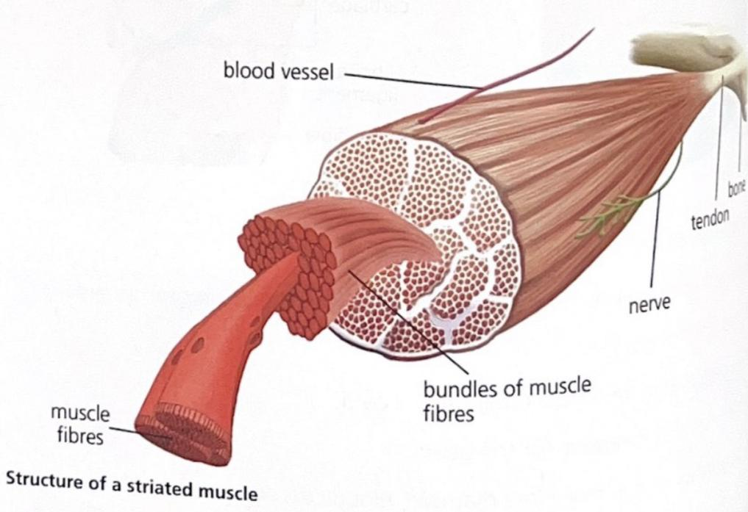
Muscles - MUSCLE STRUCTURE
Muscles are formed by groups of muscle tissues that are made up of elongated muscle cells.
Both the muscle tissues and the whole muscle itself are covered by a protective layer. The point where all of the protective layers join is where the tendons are forming the junction between muscles and bones. Tendons resist stretching movements and this is why when the muscle contracts they transmit the movement to the bone.

Slide 19
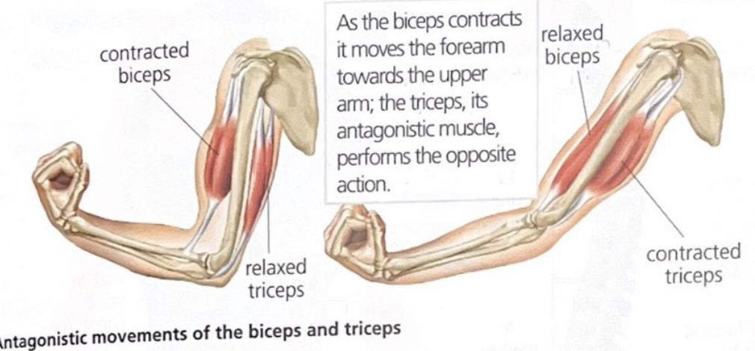
Muscles - MUSCLE CONTRACTION
Muscles contract by widening and shortening their fires. In order to create this movement a motor neuron needs to send the order to the muscle. Then, the muscle cells produce the necessary energy. This energy is obtained from the process of aerobic cellular respiration, which requires an energy molecule (generally glucose) and oxygen.
The coordinated contractions of several muscles are needed to produce adequate movements. Muscles that cooperate to perform one unique movement are called agonists. Antagonists, however, perform movements in opposite directions: when one contracts, the other one relaxes.

Slide 20
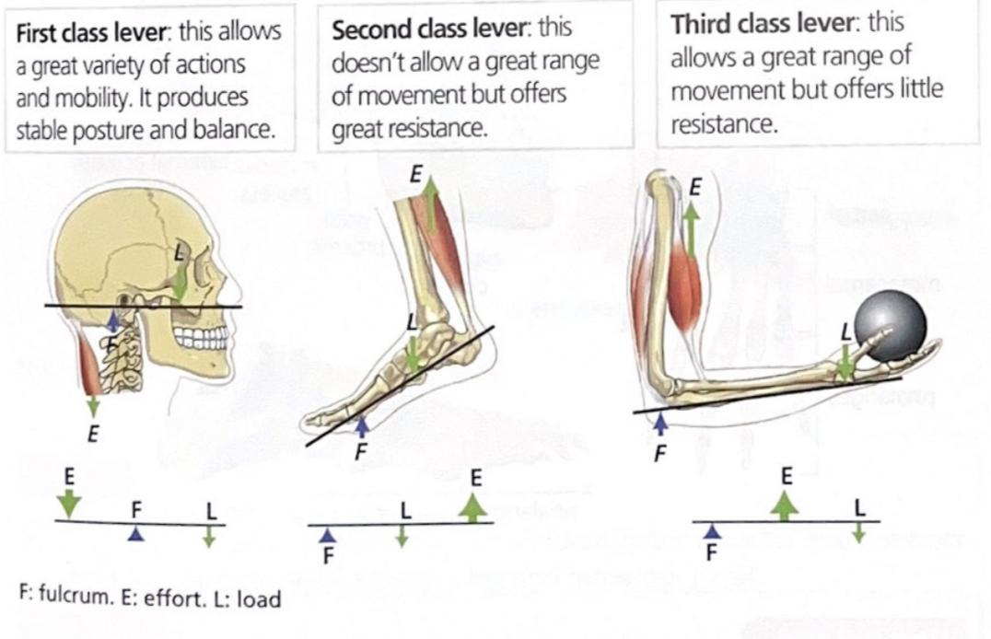
Muscles - MUSCLE CONTRACTION
Muscles cannot produce movement on their own. In order to do so, they need the help of joints and bones. Together, this system works as a lever. Remember that all levers need three different elements:
The fulcrum (f): where the lever rests in order for the two opposing forces to act.
The effort (e): the point where the force is applied in order to favour movement.
The load (l): where the force that is opposing movement is applied.

Slide 21
Muscles - MUSCLE CONTRACTION
Humans display three types of lever systems:
First class lever: this allows a great variety of actions and mobility. It produces stable posture and balance.
Second class lever: this doesn't allow a great range of movement but offers great resistance.
Third class lever: this allows a great range of movement but offers little resistance.

Slide 22
Thank you!

